Slide 1
Actors vs Shared Memory: two models at work on
Big Data application frameworks
2018.6.11

Slide 2
Abstract
This work aims at analyzing how two different concurrency models,namely the shared memory model and the actor model, can influence the development of applications that manage huge masses of data, distinctive of Big Data applications. The paper compares the two models by analyzing a couple of concrete projects based on the MapReduce and Bulk Synchronous Parallel algorithmic schemes. Both projects are doubly implemented on two concrete platforms: Akka Cluster and Managed X10. The result is both a conceptual comparison of models in the Big Data Analytics scenario, and an experimental analysis based on concrete executions on a cluster platform.

Slide 3
Programming platforms
X10:
An open-source object-oriented programming language designed for productive high performance programming of parallel and multi-core computer systems.
The computation is spread over a set of places, each of which holds data and hosts asynchronous activities that operate on local data.
Objects residing in one place may contain references (GlobalRefs) to objects residing in other places.
The finish statement waits for the termination of every activity spawned by S ei- ther locally or at a remote place.

Slide 4
Programming platforms
Akka:
Actors are objects that encapsulate state and behavior; they communicate exclusively by asynchronously exchanging messages which are placed into the recipient’s mailbox.
The environment takes care of the actor mailbox and guarantees that a single messages is processed at a time.
Use the actor references (ActorRef) to send messages without having to worry about whether the recipient resides on the same node of the sender or not.

Slide 5
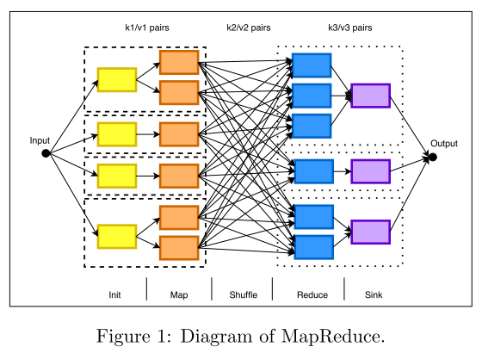
MapReduce
Initialization step: data are loaded in the initial (key,value) pairs, in order to process them in the Map step.

Slide 6
MapReduce
Map step: each node applies the mapper function to the local (key,value) pairs obtaining intermediate pairs.

Slide 7
MapReduce
Shuffle step: each node redistributes intermediate pairs produced by the mapper function, such that all values belonging to one key are located on the same node.

Slide 8
MapReduce
Reduce step: each node now processes each group of pairs, per key, in parallel, using the reducer function.

Slide 9
MapReduce
Sink step: it processes the Reduce output to apply some final operation like storing the results.

Slide 10
MapReduce
MapReduce can take advantage of locality of data, by processing them on or near the storage assets in order to reduce the distance over which they must be transmitted.
When designing a MapReduce algorithm, the author needs to choose a good trade-off between the computation costs and the communication costs of the shuffle step.
In the Big Data scenario communication cost often dominates the computation cost.

Slide 11
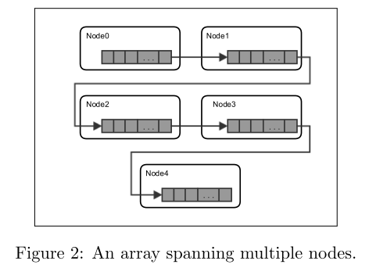
Sorting a distributed array with MapReduce

Slide 12
Sorting a distributed array with MapReduce
Five steps.
Using “essential data” instead of the whole element is convenient because v1i might be too heavy to be transferred from a node to another during the intermediate steps.
Sink step is logically simple, but involves a huge data transfer between nodes and it is unavoidable.

Slide 13
Bulk Synchronous Parallel
BSP is best suited for the analysis of complex, very- large-scale dynamic graphs (billions of nodes, billions of edges).
BSP programs consist of a sequence of iterations, called phases, and a set of logical units that communicate by means of message passing.
An important part of the analysis of a BSP algorithm rests on quantifying the synchronization and communication that are needed.

Slide 14
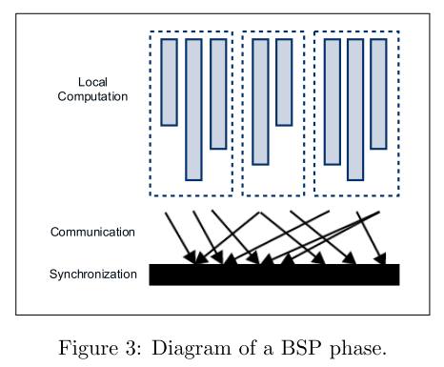
Bulk Synchronous Parallel
Local computation: parallel agents compute a user-defined function, using their own local memory. The function specifies the behavior of a single agent V in the phase S: it can read messages sent to V in phase S − 1, send messages to other agents that will be received at phase S + 1, and modify the state of V .

Slide 15
Bulk Synchronous Parallel
Communication: messages are exchanged between all agents.

Slide 16
Bulk Synchronous Parallel
Synchronization: each node waits for the others to complete their message transfer at phase S, before starting phase S +1.

Slide 17
Sparse graph exploration with BSP
Each vertex has a parent field and an inbox listing the received messages.
Vertex checks the value of its parent field, if it has a non-null value than it deactivates itself.
Otherwise (i) it sets its parent field with the content of the first received message, (ii) than it sends a message to every target vertex of any out-coming edge, (iii) and finally deactivates itself.

Slide 18
Implementation and code style comparison
The projects based on Akka are formed by a larger number of modules than those in X10.
X10 views the cluster at an higher abstraction level than Akka.
In X10 the main control flow is rendered as a control loop that asynchronously spawns code to be executed in every place.
In Akka the control flow is spread on several modules taking advantage of the aggregator pattern.

Slide 19
Implementation and code style comparison
Starting an X10 execution environment is not so different from starting any other mono-machine program.
Akka Cluster has instead a dynamic and decentralized view of the cluster,which makes the startup more complex.
X10 provides a centralized control of the array.
Akka independently manage individual slices on every node.

Slide 20
Implementation and code style comparison
X10 is a language with a shared memory model, and the insertion of messages in this list is allowed to all the active agents at the current phase.
atomic block
Akka: UDP protocol, large messages such as those exchanged in the Sink step of the MapReduce projects, have to be chunked, and then re-compacted, by the programmer.
X10 shines on the MapReduce application: inter-node parallelism
Akka’s asynchronous programming style shines on the scale-up: intra-node concurrency

Slide 21
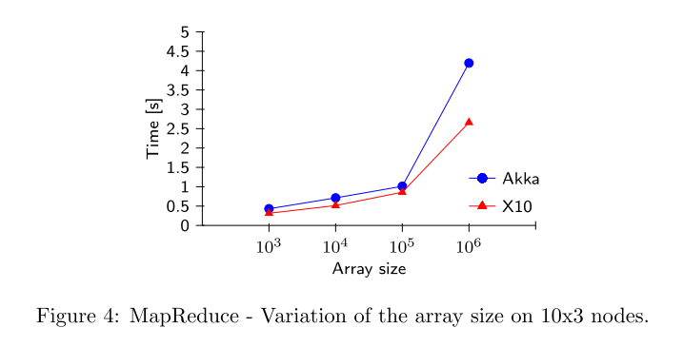
Experiment

Slide 22
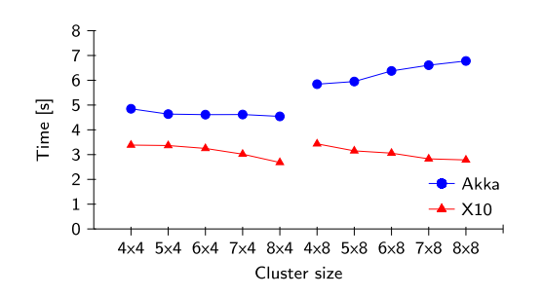
Experiment

Slide 23
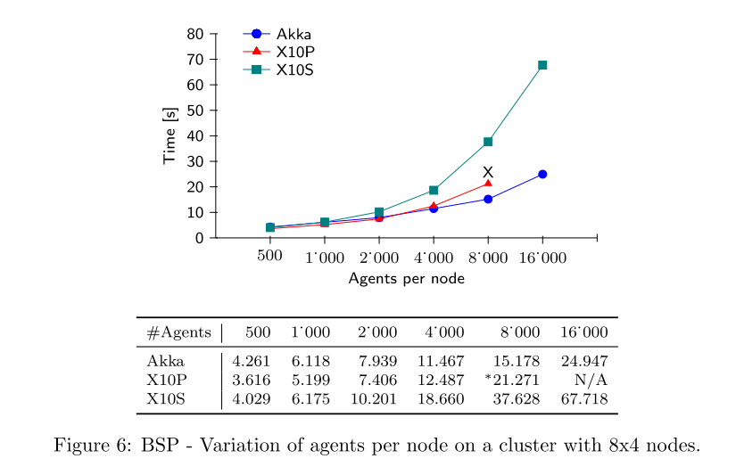
Experiment

Slide 24
THANK YOU

